Slide 1
Deployment

Slide 2
Database size in 1 year
Total in 1 year
 | 1 row | 1 day | 1 year | 1 year byte
account | 338 | 50 | 18250 | 6168500
catogory | 35 |  | 10 | 350
favorite | 60 | 500 | 182500 | 10950000
report | 4063 | 10 | 3650 | 14829950
result | 4302 | 1000 | 365000 | 1.57E+09
trafficinformation | 4834 |  | 200 | 966800
trainimage | 524 |  | 2000 | 1048000
 |  |  |  |  | in MB
 |  |  | Total | 1.604E+09 | 1529.878

Slide 3
Server size in 1 year
Data in server
 | 1 image (kb) | 1 day | 1 year | 1 year kb
trafficImage | 30 |  | 200 | 6000
trainImage | 10 |  | 2000 | 20000
searchImage | 150 | 1000 | 365000 | 54750000
Database |  |  |  | 1566595
 |  |  |  |  | in MB | in GB
 |  |  | Total | 56342595 | 55022.07 | 53.73249

Slide 4
Data size in mobile
Data in mobile
 | 1 image (kb) | 1 day | 1 year | 1 year kb
trafficImage | 30 |  | 200 | 6000
trainImage | 10 |  | 2000 | 20000
searchImage | 150 | 2 | 730 | 109500
Database |  |  |  | 10240
 |  |  |  |  | in MB
 |  |  | Total | 145740 | 142.3242

Slide 5
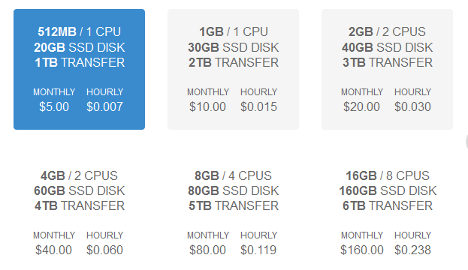
Digital Ocean VPS

Slide 6
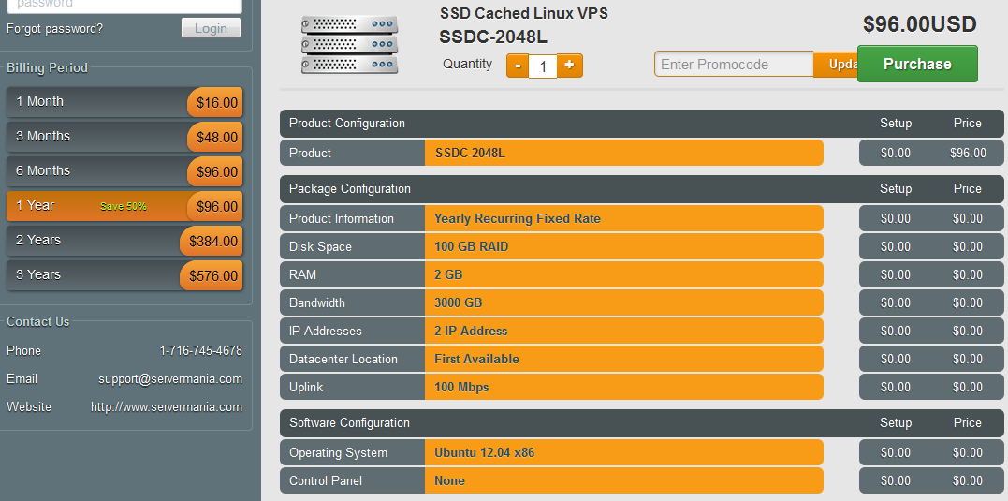
Server Mania

